Slide 1
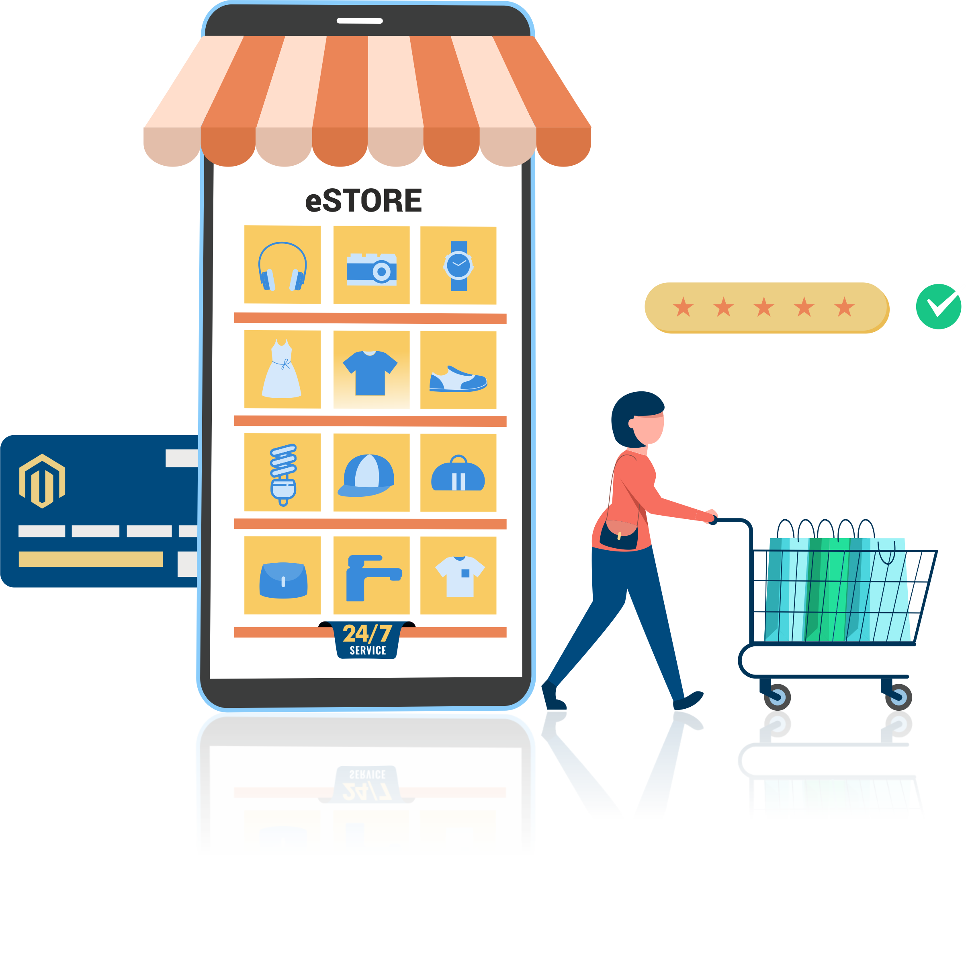
eCommerce Landing page Creative image

Slide 2
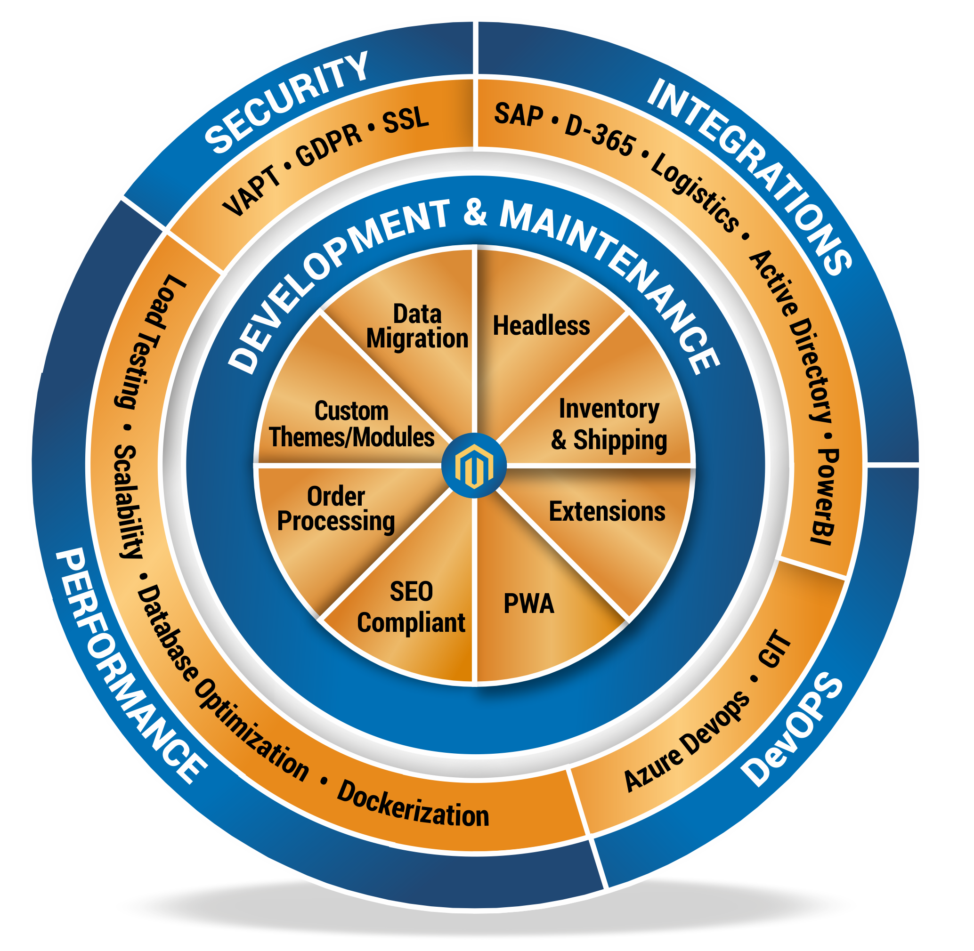
eCommerce Magento Wheel

Slide 3



























eCommerce Magento icons
Augment Reality
Chatbots
Custom eCommerce Website Design
Custom Shopping Cart
Custom Themes-Modules
Delivery
Design & Theming
Development & Integration
Distributor & Dealer Module
E-Commerce Marketplace integration
E-Commerce Store Customization
ERP-CRM
Delivery
Microinteractions
Migration & Upgrade
Mobile Friendly Website Development
Multiple Payment
Multi-Store eCommerce Development
Omni Channel
Payment & Logistics Integration
Point of Sale Integration
SAP Integration
Social Media Integration icon
Store Locator
Strategy & Planning
Testing
VAPT Compliance

Slide 4
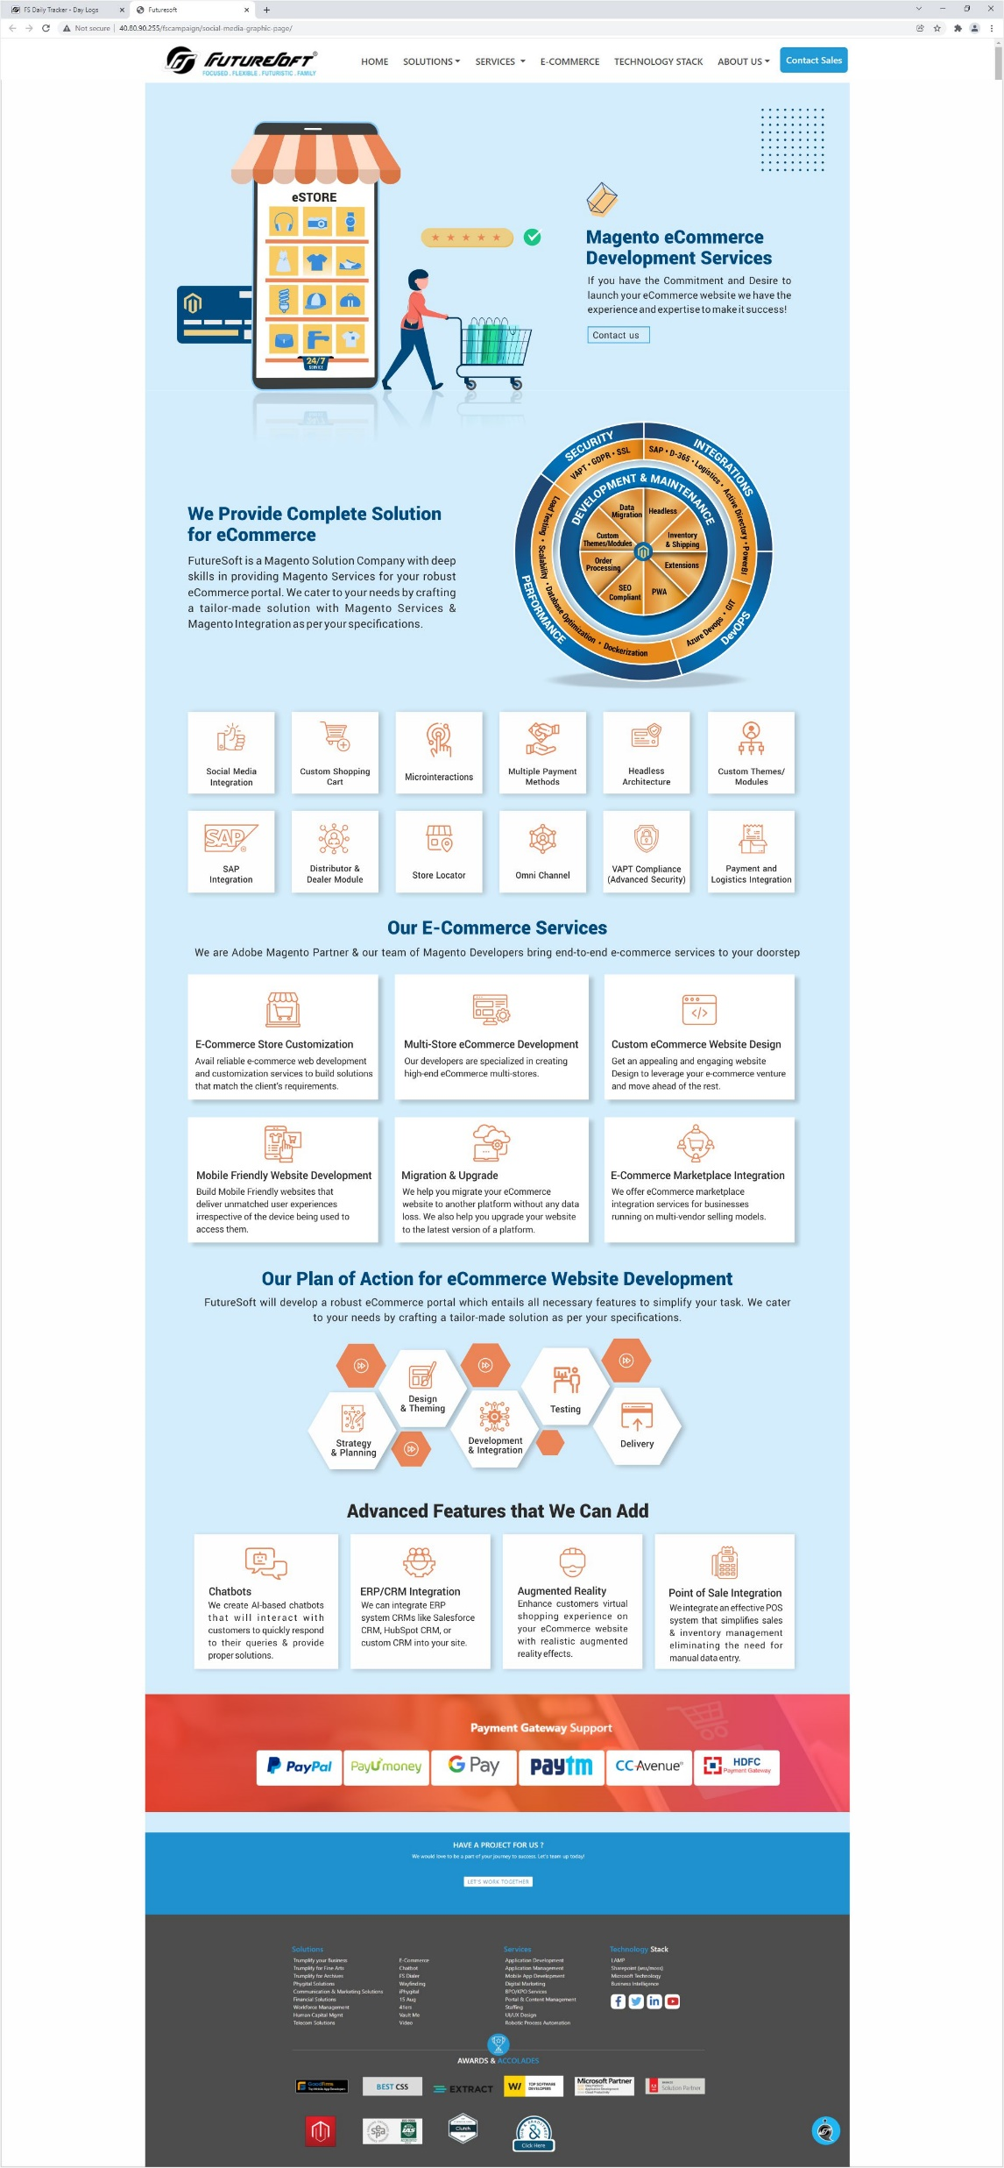
eCommerce Magento Landing Page

