Slide 1

Shopify Landing page Creative

Slide 2

Shopify Landing page Creative

Slide 3








Shopify Landing page icons
Abandoned Cart
Cost Effective
Experienced Team
Great Analytics
Guaranteed Technical Support
Multiple Stores
Safety & Security
Unimaginable SEO Tools

Slide 4
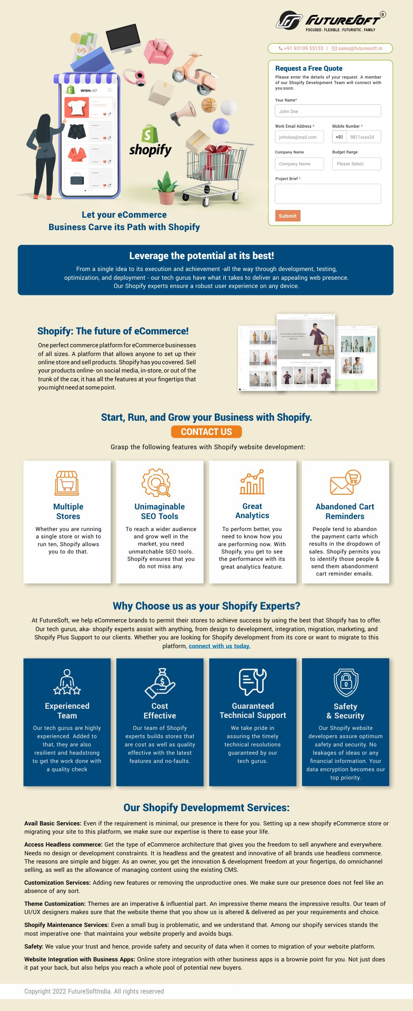
Shopify Landing Page

